Slide 1

Mr Fethy Letaief M1interctive revision

Slide 2
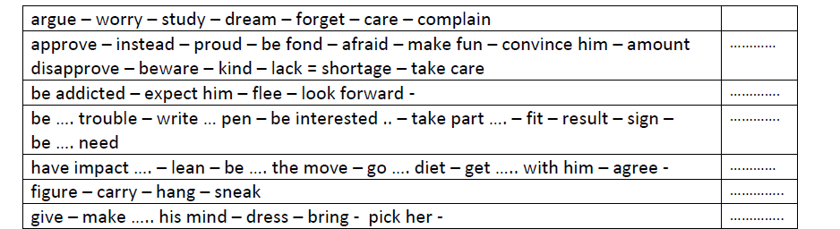
Complete the table with the right preposition to – in – up – about – of – on – out
Prepositional verbs
about
of
to
in
on
out
up
Complete the following sentences with words from the above box
approve of
figure out
His parents don’t ……………………… his overspending. He should ……………………….. that money is hard-earned.
sneak out
A growing number of teeangers ……………………….. and leave their families which may ………………………… getting themselves ………………………….. namely becoming …………………………… drugs.
result in
in trouble
addicted to

Slide 3
Module 1 Lexis
Match a words from A to alternatives from B that complete them
A | B
Set down / break / respect Reduce / increase Packed Get / obtain Purchase / buy Extra Nuclear / extended Rock / move gently and sofltly Obstinate / disobedient Lenient = permessive ≠ conservative = severe | sweets from the kiosk pocket money a good mark family teenagers a diploma the baby the rules lunch parents allowance
Set down / break / obey the rules
Reduce allowance / pocket money
Packed lunch
Get allowance / a good mark / a diploma
Purchase sweets from the kiosk
Extra pocket money
Nuclear family
Rock the baby
Obstinate teenagers
Permessive parents

Slide 4
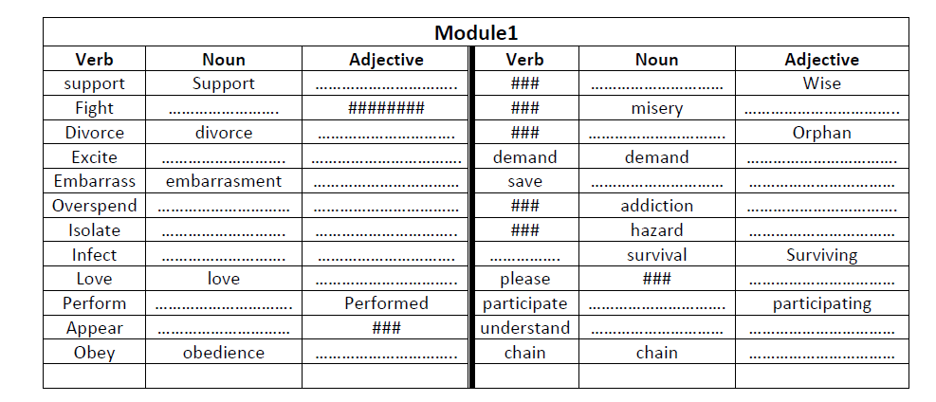
Supportive
wisdom
fight
miserable
divorced
orphanage
excitement
Exciting/ed
demanding
Embarrassing/ed
Savings/safety
Saved /safe
overspending
overspending
Addicted/ive
Isolation
Isolated
hazardous
infection
Infected
Survive
Lovely / loving
Pleased/ant
performance
Participation
appearance
understanding
understanding
obedient
chained

Slide 5
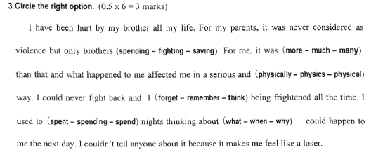
To fight = to quarrel = to argue
Parallelism : adj and adj / noun and noun / adverb and adverb
More + THAN
Many+ plural noun
Used to + bare inf → habit in the past

Slide 6
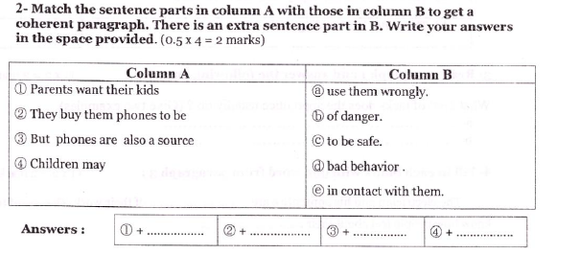
C
E
B
A
Want / Manage /Plan /expect /promise /allow + to do
Modals ( must , can , may , might , should , could ) + do
Let + do
help + do / to do

Slide 7
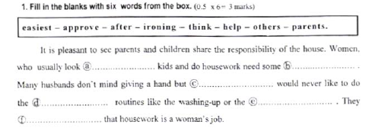
after
help
others
easiest
ironing
think

Slide 8
Useful ideas for writing
Advice to teenagers | Advice to parents
show them you are grown up and reliable sit them and talk to them calmely and respectfully strengthen your relationship by sharing family roles and show how responsible you are try to be less demanding and more understanding explain to them that life has changed and that requires change of attitude make them feel proud of you by doing well at school be coopertaive and show how supportive you are shouting and arguing is useless and maya dd mud to clay ( make things worse) | you ought to be good listeners and try to understand and give them the opportunity to talk it out be closer to them and make them feel at ease with you (comfortable) show them your affection and care and stand by them in their troubles try to cover their expenses reasonably to make them feel equal to their peers don’t make them feel misunderstood or neglected assign tasks ( roles) to them to make them feel essential family members violence is not the right solution , it’s better to discuss things

Slide 9
Pocket money | Sharing with the housework
Parents : teach your kids the value of money and that’s hard –making neither be mean nor very generous , make them feel responsible about their spending giving allowance makes kids feel important members of the family give them extra pocket money in case they help more with the housework kids : show them you are responsible enough to deal well with the pocket money you get save part of your pocket money avoid being demanding and try to be thoughtful and understanding | the burden of housework shouldn’t fall on one member of the family standing by each others strengthens family ties and makes members feel closer taking a part in the house chores teaches kids responsibility and prepares them for the future there will be less conflicts and arguments between family members namely the husband and wife if everyone helps sharing means caring and in a family dividing tasks makes the housework easier family cooperation is necessary to have a warm and favorable atmosphere

Slide 10
Home safesty
parents should never let their kids unattended at home ( not under control)
parents need to supervise their kids in dangerous (hazrdous) parts of the house namely the kitchen and the bathroom
prevention is better than cure that’s why parents should talk to their kids about the risks at home regularly
parents must keep medicines , detergents , cleaners and every risky thing out of the reach of kids
never let kids alone with pets and those pets should be well -cared for

Slide 11
Suggested topic
Write a 12-line post in which you talk about ways to have stronger family relationships and more united families

